Slide 1

The Powerflow Module

Slide 2
Powerflow Overview
Powerflow is the fundamental power system analysis tool.
Given the voltage of the generators and the load on the system it determines voltage at all points on the system.
This in turn defines the currents on the system and indicates if the system is properly loaded.

Slide 3
Powerflow Overview
Transmission Systems
  Powerflow was originally limited to the transmission system.
  Many assumptions were made in the early developments of transmission power flow. e.g. only positive sequence.
Distribution Systems
  Powerflow was not originally performed since stability and voltage sag issues were minimal.
  Was initially based on simple circuit equivalents.
  Sequential components were used, but found to be inappropriate.
  Recent work has focused on more complete modeling.

Slide 4
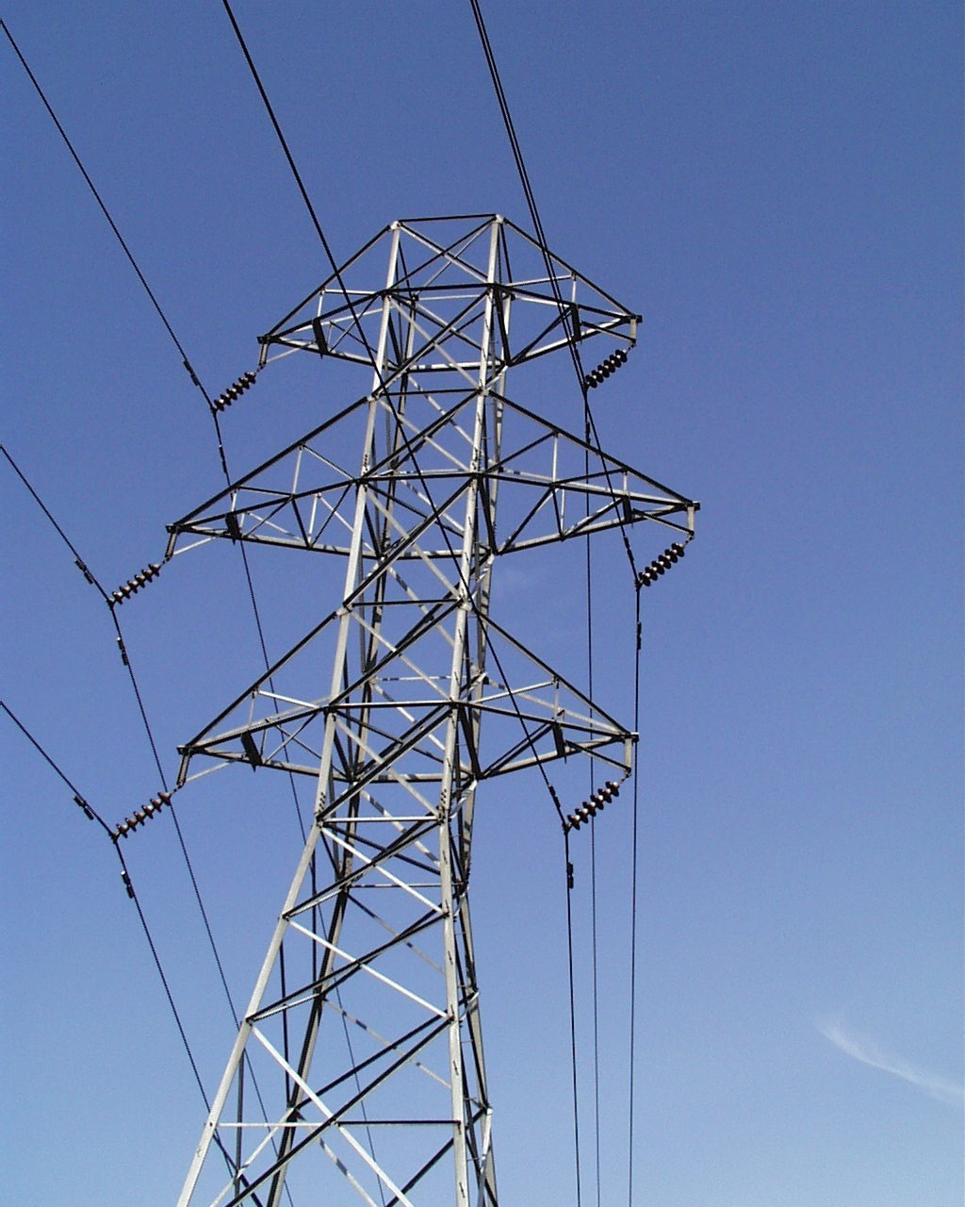
Transmission System

Slide 5
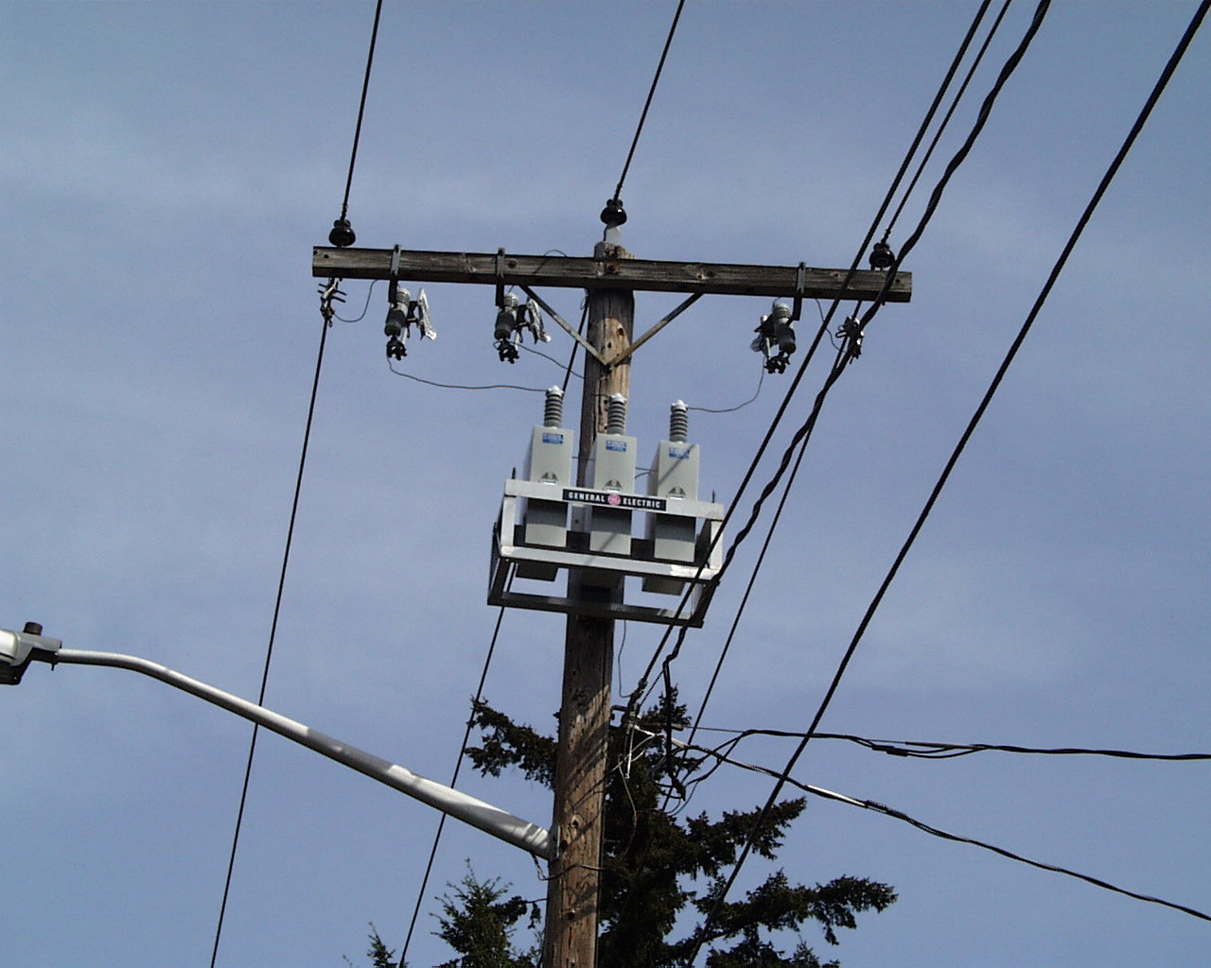
Distribution System

Slide 6
System Representations
Positive Sequence
Three-phase
System is assumed to be three-phase balanced.
Single-phase equivalent models are used.
Each phase is explicitly modeled.
Electromagnetic coupling between phases is included.
This allows for more accurate modeling including:
  Split-phase systems
  Single-phase loads
  Two-phase loads

Slide 7

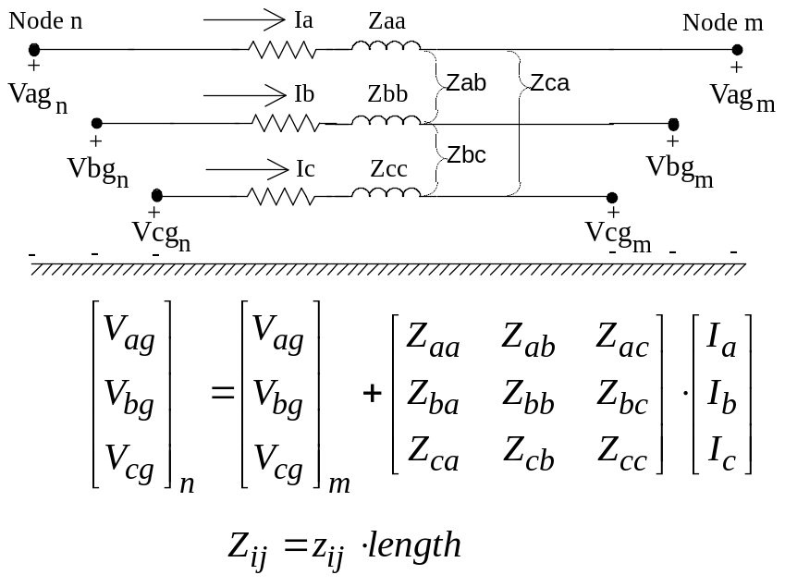



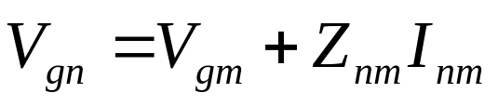
Modeling comparisons
Positive Sequence
Unbalanced
+
-

Slide 8

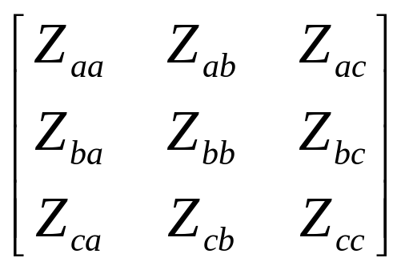
Three-phase Unbalanced
a
2.5'
b
4.5'
c
3.0'
4.0'
n
24.0'
Phase Conductor: 336,400 26/7
GMR = 0.0244 ft., Resistance = 0.306 Ω/mile, Diameter = 0.721 inch
Neutral Conductor: 4/0 6/1 ACSR
GMR = 0.00814 ft., Resistance = 0.592 Ω/mile, Diameter = 0.563 inch
Physical System
Parameterized Values
Values for Numeric Simulation

Slide 9
Powerflow Methods
Transmission Systems
  Direct Current
  Gauss Seidel
  Newton Raphson
  Decoupled
Distribution Systems
  Forward Backward Sweep
  Direct Current
  Gauss Seidel
  Newton Raphson

Slide 10
Clarification
The power flow component of GridLAB-D is separated into a distribution module and a transmission module.
  The distribution module uses three-phase unbalanced powerflow
  The transmission module uses positive-sequence powerflow
In GridLAB-D, the name of distribution module is powerflow; the name of transmission module is network.

Slide 11
Three Powerflow Solver Techniques
Forward/Backward Sweep method
  Fast and efficient
  Cannot solve for meshed systems
Gauss-Seidel method
  Easy to implement
  Applicable to diagonally dominant matrix
  Implicitly parallel
  Converges very slowly
Newton-Raphson Method
  Requires that the derivative be calculated directly
  Converge quickly for good initial values, otherwise, may fail to converge

Slide 12


Backward/Forward Sweep Method
Node n
Node m
Series Component
[Iabc]_{n}
[Iabc]_{m}
[Vabc]_{n}
[Vabc]_{m}
Backward Sweep
Forward Sweep

Slide 13
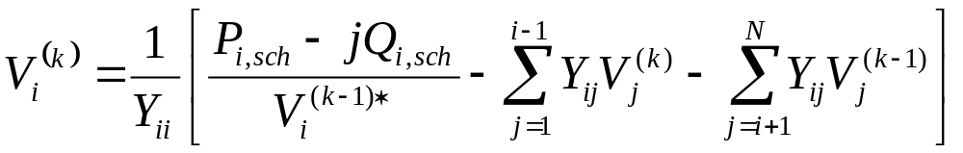
Gauss-Seidel Method
V is the node voltage
i is the current node
k is the current iteration number;
Y_{ii} is the self admittance matrix
P_{i,sch} is the scheduled real power injection
Q_{i,sch} is the schedule reactive power injection
Y_{ij} is the admittance of the line connecting node i with the j node

Slide 14
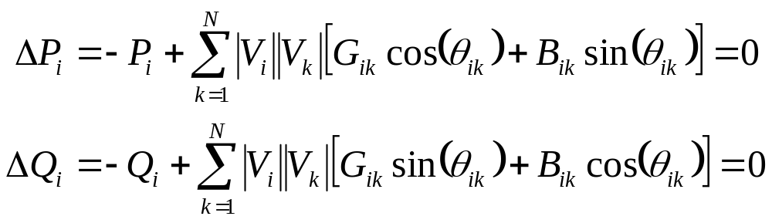
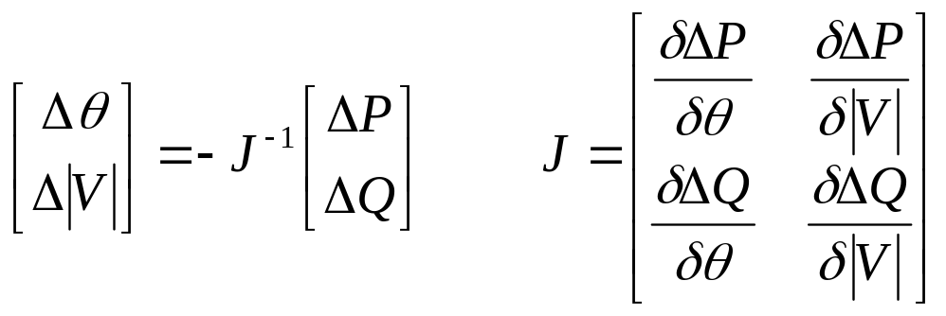
Newton-Raphson Method
P_{i} is the real power injection at node i
Q_{i} is the reactive power injection at node i
G_{ik} is real portion of the admittance between node i and k
B_{ik} is imaginary portion of the admittance between node i and k
V_{i} is the voltage magnitude at node i
δ_{i} is the voltage angle at node i

Slide 15
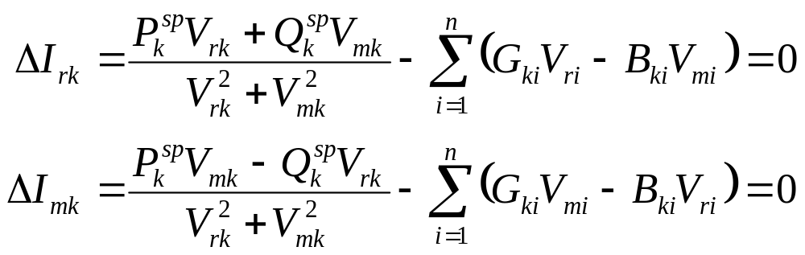
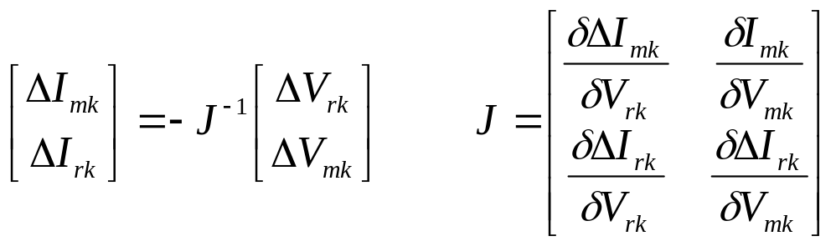
Newton-Raphson Method
P_{k} is the scheduled real power injection at node i
Q_{k} is the scheduled reactive power injection at node i
G_{ik} is real portion of the admittance between node i and k
B_{ik} is imaginary portion of the admittance between node i and k
V_{rk} is the real component of voltage at node k
V_{mk} is the imaginary component of voltage at node k

Slide 16
Powerflow Module
The powerflow module is used to simulate the distribution network.
The powerflow module of GridLAB-D utilizes the forward and backward sweep method (Kersting’s Method) for solving the power flow problem.
Gauss Seidel method was attempted but was found to be grossly ineffective.
Newton Raphson solver has been integrated.
NEW

Slide 17
How does it work?
The distribution network is handled as a system of nodes and links.
Voltage(node) and current(link) are passed along the distribution network in a series of sweeps.
The sweeps are repeated for each time step until the system converges.

Slide 18
Objects in Powerflow Module
Two main object types: Node and Link.
Most objects inherited from Node and Link.
Other objects are used to specify different configuration
  Line_configuration
  Line_spacing
  Transformer_configuration
  Regulator_configuration

Slide 19
Objects in Powerflow Module
The FBS power flow calculation is done at the level of node objects and link objects.
Node Objects
  Capacitor
  Load
  Meter/triplex_meter
Link Objects
  Fuse/Switch/Relay
  Overhead_line/Underground_line/triplex_line
  Regulator
  Transformer

Slide 20
Objects in powerflow Module
object node {
complex voltage_A[V];
complex voltage_B[V];
complex voltage_C[V];
complex voltage_AB[V];
complex voltage_BC[V];
complex voltage_CA[V];
complex current_A[A];
complex current_B[A];
complex current_C[A];
complex power_A[W];
complex power_B[W];
complex power_C[W];
complex shunt_A[S];
complex shunt_B[S];
complex shunt_C[S];}
Defines bus type (PQ/PV/Swing)
Defines maximum_voltage_error

Slide 21
Objects in powerflow Module
object load {
/* inherited from node object */
complex constant_power_A[W];
complex constant_power_B[W];
complex constant_power_C[W];
complex constant_current_A[A];
complex constant_current_B[A];
complex constant_current_C[A];
complex constant_impedance_A[Ohm];
complex constant_impedance_B[Ohm];
complex constant_impedance_C[Ohm];
}
Defines load class (residential/industrial/commercial/agricultural)

Slide 22
Objects in powerflow Module
object meter {
/* inherited from node object */
double measured_energy[Wh];
double measured_power[W];
double measured_real_power[W];
double measured_reactive_power[W];
complex measured_voltage_A[V];
complex measured_voltage_B[V];
complex measured_voltage_C[V];
complex measured_current_A[A];
complex measured_current_B[A];
complex measured_current_C[A];}
The meters are where the powerflow module interacts with the commercial modules.

Slide 23
Objects in powerflow Module
object triplex_meter {
/* inherited from node object */
double measured_energy[Wh];
double measured_power[W];
double measured_real_power[W];
double measured_reactive_power[W];
complex measured_voltage_1[V];
complex measured_voltage_2[V];
complex measured_voltage_N[V];
complex measured_current_1[A];
complex measured_current_2[A];
complex measured_current_N[A];}
The triplex meters are where the powerflow module interacts with the residential modules.

Slide 24
Objects in powerflow Module
object overhead_line {
string name;
string phases;
object from;
object to;
double length[ft];
object configuration;}
underground_line and triplex_line follow the same format
Defines nodes the line is connect to and from
configuration defined by separate object
With configuration and length, determines all relevant matrices for powerflow calculations

Slide 25
Objects in powerflow Module
object line_configuration {
object conductor_A;
object conductor_B;
object conductor_C;
object line_spacing;}
overhead_line and underground_line both utilitize this same format
triplex_lines use triplex_line_configuration with conductors as conductor_1, conductor_2, conductor_N, but no spacing
conductor and line_spacing defined by separate object

Slide 26
Objects in powerflow Module
object overhead_line_conductor {
double geometric_mean_radius;
double resistance;}
triplex_line_conductor contains the same parameters
geometric_mean_radius defines the size of the conductor
resistance defines the resistance of the conductor

Slide 27
Objects in powerflow Module
object underground_line_conductor {
double outer_diameter;
double conductor_gmr;
double conductor_diameter;
double conductor_resistance;
double neutral_gmr;
double neutral_resistance;
double neutral_diameter
double neutral_strands;
double shield_gmr;
double shield_resistance;}
Defines all relevant parameters of underground conductor

Slide 28
Objects in powerflow Module
object line_spacing {
double distance_AB;
double distance_BC;
double distance_AC;
double distance_AN;
double distance_BN;
double distance_CN;}
Defines spacing requirements for computing parameters of lines
triplex_line does not use spacing information

Slide 29
Objects in powerflow Module
object transformer {
/* inherited from link object */
object from;
object to;
double power_in[W];
double power_out[W];
object configuration;}
Specific transformer parameters defined by transformer_configuration
There are multiple transformer types

Slide 30
Objects in powerflow Module
object transformer_configuration {
Enumeration connection_type;
Enumeration install_type;
… continued}
Connection types
  WYE_WYE
  Delta_Delta
  Delta_Gwye
  Single_Phase
  Single_Phase_Center_
  Tapped
Install_type
  POLETOP
  PADMOUNT
  VAULT

Slide 31
Objects in powerflow Module
object transformer_configuration {
double primary_voltage[V];
double secondary_voltage[V];
double power_rating[kVA];
double power_rating_A[kVA];
double power_rating_B[kVA];
double power_rating_C[kVA];
double resistance[pu.Ohm];
double reactance [pu.Ohm];
complex impedance[pu.Ohm];}

Slide 32
Objects in powerflow Module
object regulator {
/* inherited from link object*/
object configuration;}
Defines voltage regulator for feeders
Specific regulator parameters defined by regulator_configuration, similar to transformer_configuration

Slide 33
Objects in powerflow Module
object regulator_configuration {
enumeration connect_type;
double band_center[V];
double band_width[V];
double time_delay[s];
double raise_taps;
double lower_taps;
double current_transducer_ratio;
double power_transducer_ratio;
double compensator_r_seeting_A[V];
double compensator_r_seeting_B[V];
double compensator_r_seeting_C[V];
double compensator_x_seeting_A[V];
double compensator_x_seeting_B[V];
double compensator_x_seeting_C[V];
string CT_phase;
string PT_phase;
double regulation;
enumeration control;
enumeration type;
int tap_pos_A;
int tap_pos_B;
int tap_pos_C;}
Defines all parameters of regulator
control defines whether automatic tap changes or fixed tap changes

Slide 34
Node to node Connection
Connected via a link object
  object overhead_line:12 {
  phases "ABCD";
  from node:1;
  to node:2;
  length 2000;
  configuration line_configuration:300;
  }
Connected via parent/child relationship (length = 0)
  object node:2 {
  phases "ABCD";
  parent node:1;
  }

Slide 35
IEEE Load Format
IEEE Test feeders provide loads in power values
GridLAB-D accepts constant power, constant impedance, and constant current loads
A conversion is necessary to properly model constant impedance and constant current loads within GridLAB-D

Slide 36
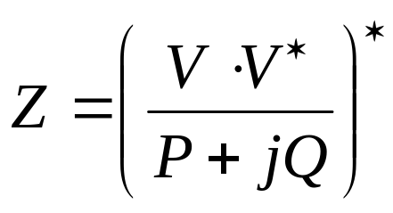
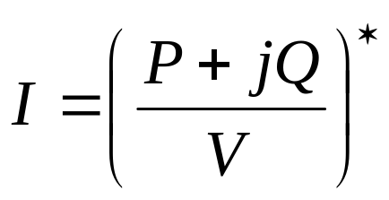
IEEE Load Format - Conversion
Convert constant impedance
Convert constant current
Be sure to use V as the appropriate phase voltage, not the base voltage, especially for constant current calculation!

Slide 37
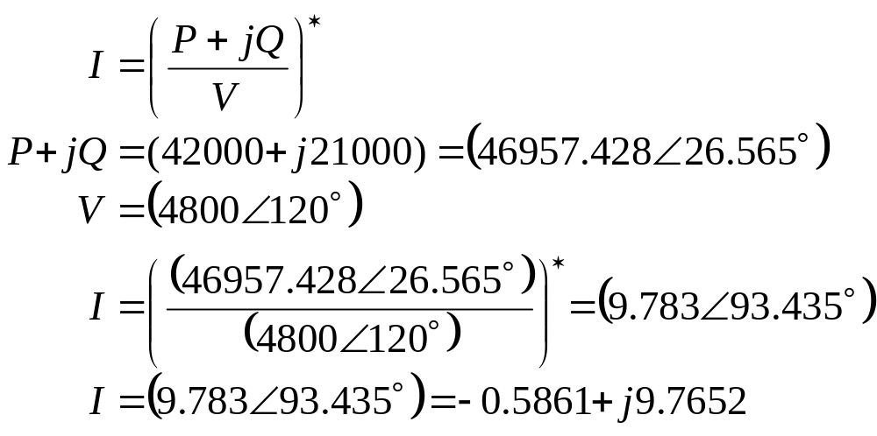
IEEE Load Format – Current Example
IEEE 37-node feeder node 741
  Delta connected
  Constant current
  42 kW and 21 kVAr on phase C

Slide 38
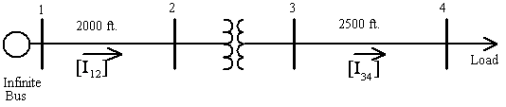
Feeder Example
IEEE 4 Node Feeder
It is looked at as a system of nodes and links
Use backward/forward sweep method to solve

Slide 39
Powerflow Output
Three phase voltage at each node, including inherited objects
Power in and Power out at each link, including inherited objects
Log of events (KML if specified)

Slide 40
Sample Powerflow Output
Load object: (node)
Transformer object: (link)
Name | constant_power_A | constant_power_B | constant_power_C | voltage_A | voltage_B | voltage_C
(load:11) (#11) | 1.8e+006+871780j W | 1.8e+006+871780j W | 1.8e+006+871780j W | 1918.94-271.698j V | -1266.24-1576.4j V | -697.555+1873.95j V
Name | configuration | status | from | to | power_in | power_out | phases
(transformer:8) (#8) | transformer_configuration:4 | CLOSED | node:7 | node:9 | +7.17672e+006 W | +6.81855e+006 W | ABCD

Slide 41
Newton-Raphson
Solves both radial system and meshed system
Gauss Seidel solver is extremely slow
  Implementation:
    module powerflow {
      solver_method NR; //Newton Raphson
    }
    Returns zero if there is no solution
    Returns positive number (iterations completed) if solved
    Returns negative number (# of iterations) when the solver could not converge

Slide 42
Newton_Raphson
Two structures
  typedef struct {
  int type; // bus type (0=PQ, 1=PV, 2=SWING)
  complex *V[3]; // bus voltage
  complex *S[3]; // constant power
  complex *Y[3]; // constant admittance (impedance loads)
  complex *I[3]; // constant current
  double kv_base; // kV basis
  double mva_base; // MVA basis
  } BUSDATA;
  typedef struct {
  complex *Y[3][3]; // branch admittance
  int from; // index into bus data
  int to; // index into bus data
  double v_ratio; // voltage ratio(v_from/v_to)
  } BRANCHDATA;

Slide 43
Exercise 4.1
Load one IEEE 4-node test feeder, run it, and have a look at the output file.
Run the feeder with different transformer configurations and notice the effects.

Slide 44
Exercise 4.2
Load the IEEE 37-node test feeder, which will be used in the exercises of reliability module and market module.
Fix the model to include the missing line.
Replace this line with a Delta-Delta transformer.
Connect extra load via node-node connections.

Slide 45
Exercise 4.3
Load the IEEE 123-node test feeder, with building loads attached.
Examine the interface between the powerflow module and the residential module at the triplex meter objects.

